Slide 1



Twin Image Removal in Holography Via Machine Learning
Marshall Hammond
Mentor: Christopher Mann
Applied Physics and Materials Science
Northern Arizona University
Arizona NASA Space Grant Symposium April 22 2023

Slide 2
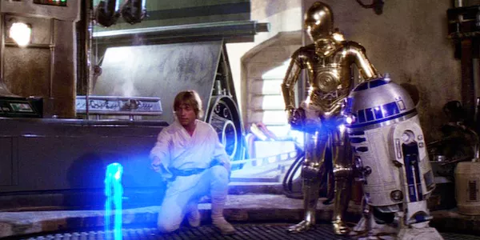
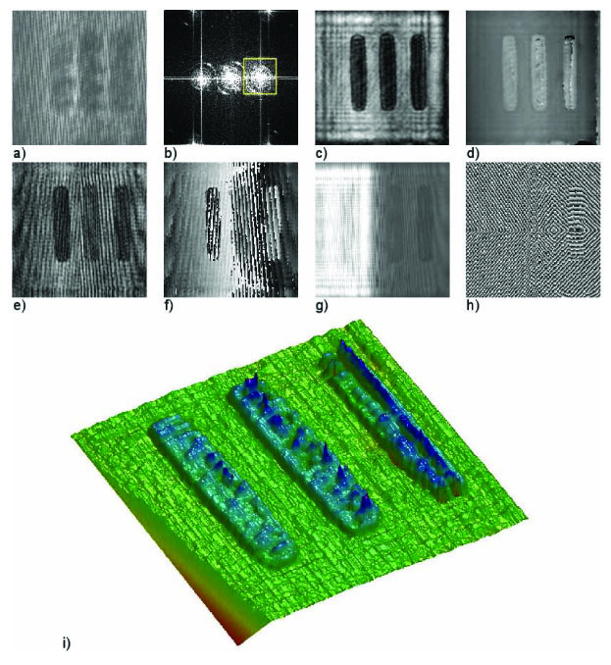
What is holography?
Holograms are not a 3D projection
Source: https://cdn.mos.cms.futurecdn.net/2UVE74H56mgtWn7St5VsVS-1920-80.jpg.webp
It is a modern imaging technique that can capture 3D information of samples.
This is typically captured using a laser or other known wave source.

Slide 3
In Line Hologram capture
A setup such as this is used to capture 8-12 holograms at different z distances
The laser is aimed through the sample and the distance between sample and camera is the reconstruction distance
The camera records the intensity of the image
Final Reconstructed image

Slide 4
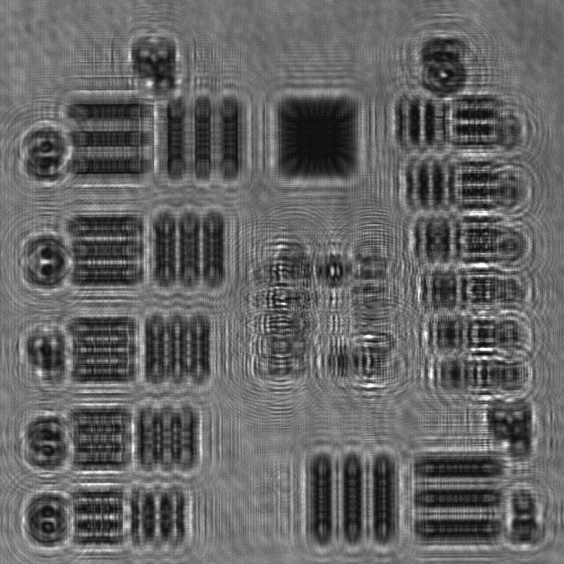
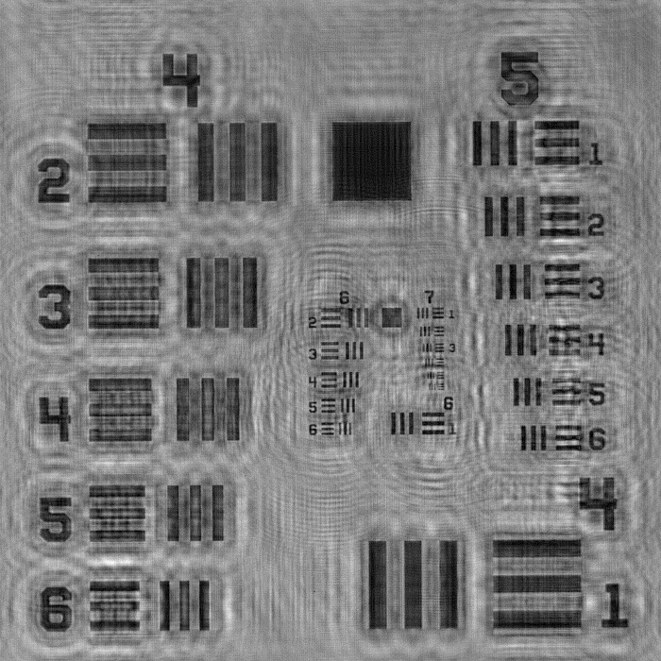
Hologram Example
Phase retrieval is critical to remove the twin image (noise)
Out of focus raw hologram
Focused Hologram with twin image
In Focus Twin Image Removed Hologram

Slide 5
Amplitude and Phase
Cameras only capture the intensity which is related to the amplitude and cannot directly record the phase
The phase is critical for a full in focus reconstruction and 3D perception and depth information
Phase is indirectly captured from the interference patterns the sample creates and can be reverse engineered and found that way

Slide 6
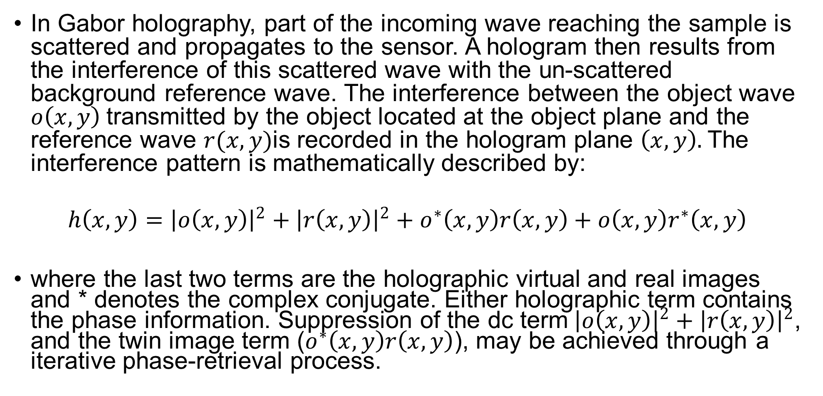
Phase Retrieval
In Gabor holography, part of the incoming wave reaching the sample is scattered and propagates to the sensor. A hologram then results from the interference of this scattered wave with the un-scattered background reference wave. The interference between the object wave $o\left(x,y\right)$transmitted by the object located at the object plane and the reference wave $r(x,y)$is recorded in the hologram plane $\left(x,y\right).$The interference pattern is mathematically described by:
$$h\left(x,y\right)={\left|o\left(x,y\right)\right|}^{2}+{\left|r\left(x,y\right)\right|}^{2}+o^{∗}\left(x,y\right)r\left(x,y\right)+o\left(x,y\right)r^{∗}\left(x,y\right)$$
where the last two terms are the holographic virtual and real images and * denotes the complex conjugate. Either holographic term contains the phase information. Suppression of the dc term${\left|o\left(x,y\right)\right|}^{2}+{\left|r\left(x,y\right)\right|}^{2}$, and the twin image term ($o^{∗}\left(x,y\right)r\left(x,y\right)$), may be achieved through a iterative phase-retrieval process.

Slide 7
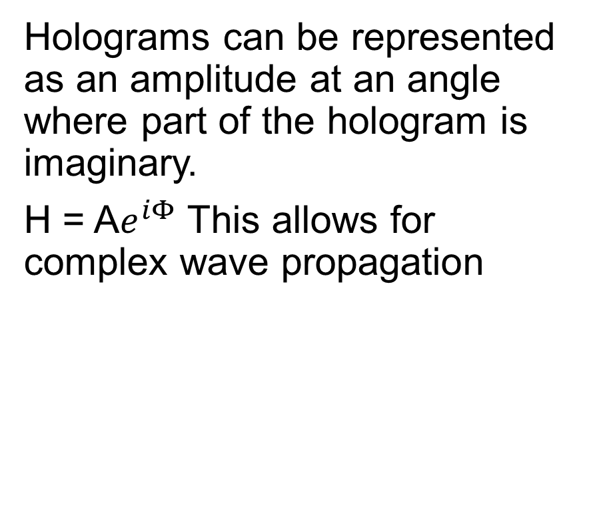
Phase Retrieval in Action
Holograms can be represented as an amplitude at an angle where part of the hologram is imaginary.
H = A$e^{iΦ}$ This allows for complex wave propagation
Wave propagation
IFFT
FFT
The propagated field is compared with the actual measured field and updated based on a factor β and the difference from measured
Z2
Z1
This process is repeated until the phase is iteratively converged upon when the propagated field matches the measured

Slide 8
Problems and Solutions
Phase retrieval requiring multiple images and exact knowledge of them is impractical for nonscientific endeavors and gathering can be time consuming
This project aimed to use machine learning to train a neural network to be able to take as input an out of focus with twin image hologram and output the predicted phase and corresponding twin image removed, noise free hologram
Neural Networks essentially take input, put it through many parameters, and outputs something
Reinforcement Learning rewards parameters with output similar to desired and punished those resulting in bad output

Slide 9
Results
Using MATLab and its deep learning toolbox for phase retrieval and machine learning we created a neural network with proof of concept for our end goal
Synthetic data was used to train the network using manual propagation to create the twin image out of focus input required
Different techniques and more data can be used to optimize results

Slide 10
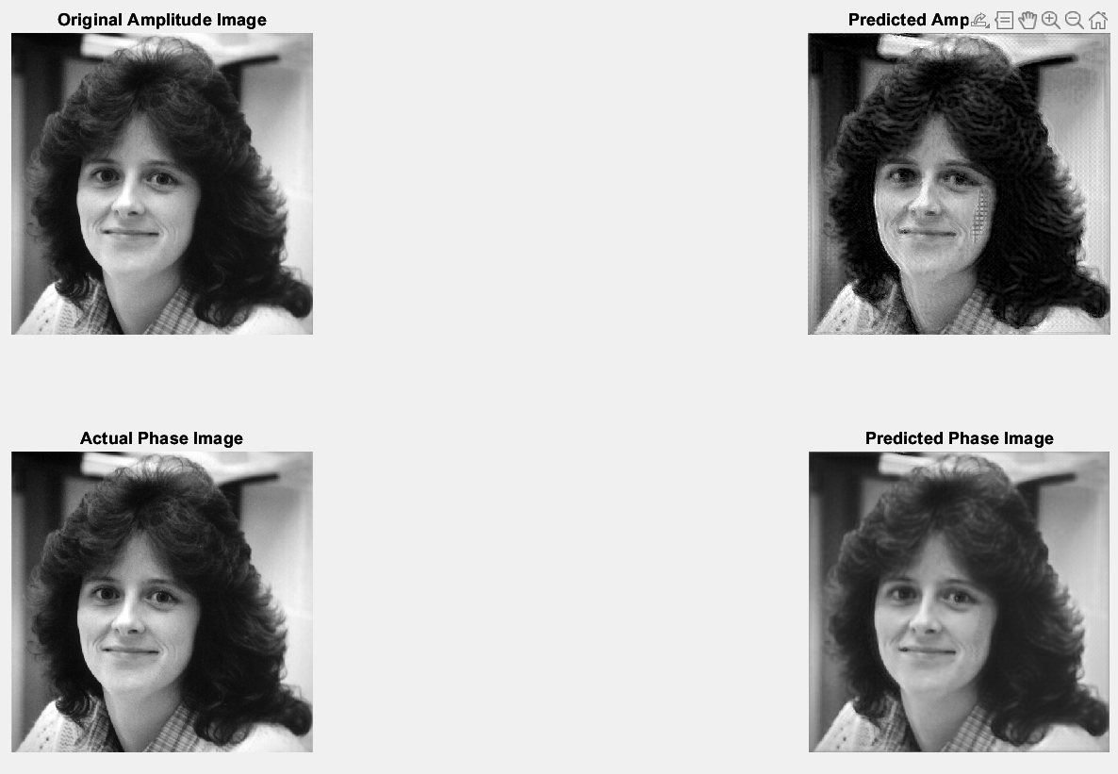
Results

Slide 11
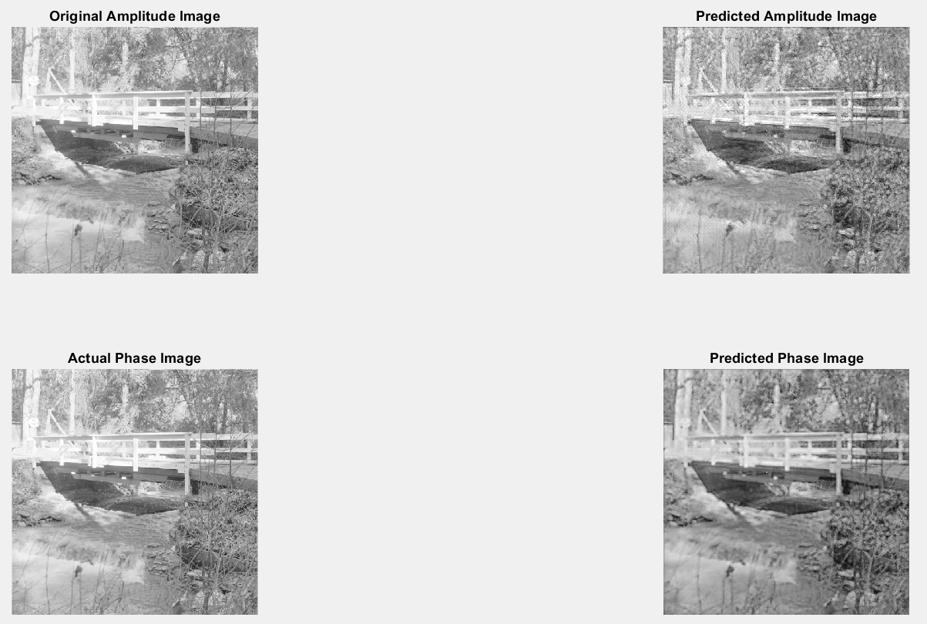
Results

Slide 12
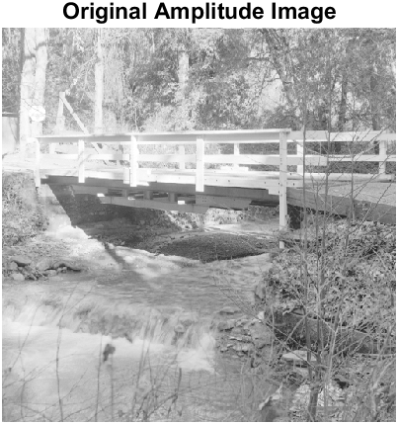
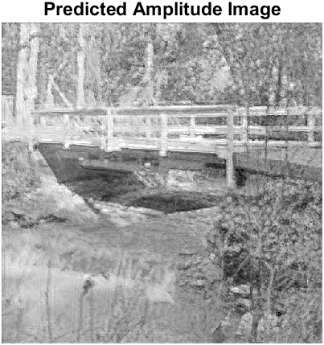
Results

Slide 13
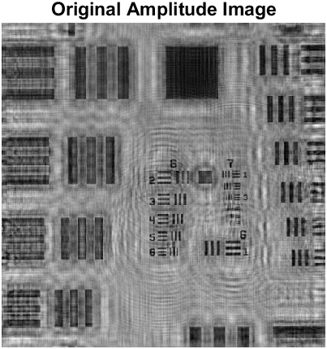
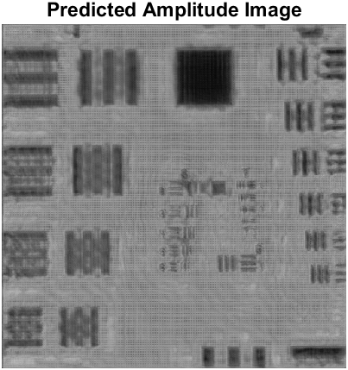
Results

Slide 14
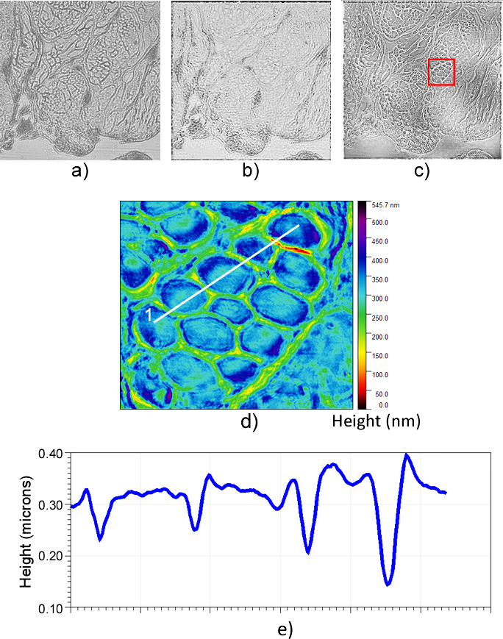
Future Goals
Gather enough real data to train effectively on a sample type and get precise results (500 – 2000+ samples)
Utilize the neural network to create mass amounts of hologram data for other projects
Implement single image holography for use with phone cameras for ease of use

Slide 15
Acknowledgements
Christopher Mann
Applied Physics and Materials Science
Arizona NASA Space Grant
Northern Arizona University
Alex Jaraba

Slide 16

Thank You

Slide 17
Other Future Goals
β value machine learning
β is normally cut in half when the change in error is very small (<.001%)
This allows the phase to change enough to find the real value without getting stuck and also still converge enough for a precise reading
This is far from optimal and can take 50-250 algorithm iterations to converge maximally without overfitting
Adaptive β calculations could considerably speed up phase retrieval

